Slide 1
DATA 824 Final Project
Abalone Dataset Analysis in R Shiny
Hayden D. Boline
26 July 2022

Slide 2
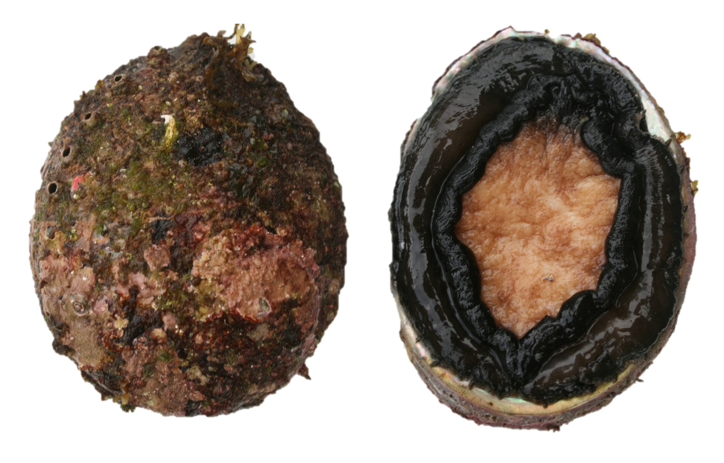
About the Data
The abalone dataset contains physical attributes of abalone such as the length or weight of 4177 abalone. The purpose of this dataset is to make use of these attributes to predict the age of abalone. The age of an abalone can be found through a meticulous process involving cutting the shell through the cone, staining it, and counting the rings using a microscope. With the difficulty of this process, it is desirable to find a method to predict the age of the abalone accurately using other measurements that are more easily taken.
The abalone dataset has no missing entries and only required a minimal amount of manipulation to prepare. The measurements were multiplied by 200 (the original data had this data divided by 200), the age (num. rings + 1.5) was approximated as 1 + num. rings for nicer looking data, and two entries were filtered out with abnormally high height measurements leaving us with n = 4175 records in the data.
“Blacklip Abalone”
(Halitosis rubra)
Variable Name
Variable Description
Data Type
sex
Sex of abalone (male, female, or “infant”)
categorical
height
Height of shell (mm)
numeric
length
Longest shell measurement (mm)
numeric
diameter
Perpendicular to length (mm)
numeric
whole.weight
Weight of abalone whole (g)
numeric
shucked.weight
Weight of abalone meat (g)
numeric
viscera.weight
Weight of abalone guts after bleeding (g)
numeric
shell.weight
Weight of abalone shell after drying (g)
numeric
age
Age of abalone calculated from num. rings (num. rings + 1)
integer

Slide 3



About the App
This application was built for the final project in the DATA 824: Data Visualization at the University of Kansas. The purpose of this app is to showcase various visualizations, interactions with data, and models on the data using R Shiny. The project repository is publicly available on GitHub.
The application layout was made using the shinydashboard package in R. This allows for a neat, useable, and modern style for the Shiny app with very little need to understand the html or CSS underneath.
The primary goal of the application is to showcase various ways of using Shiny and R to visualize and interact with data. Each page offers varying levels of customization and choices for how to visualize data, as well as other interactive elements that respond to the user’s input (e.g. making linear predictions on new data).
Page
Page Description
Data Statistics
General statistics of abalone dataset. Statistical tests including 2-sample t-test between sex measurements & linear regression tests.
Data Exploration
Various visualizations. Box plots, frequency plots, violin plots, correlation plot.
Interactive Visualization
Interactive ggplot + plotly scatterplot with choice of variables & customization of visualization parameters.
Models
Linear regression for age prediction with interactive prediction & PCA on abalone dataset.
Data
Interactive data table.

Slide 4
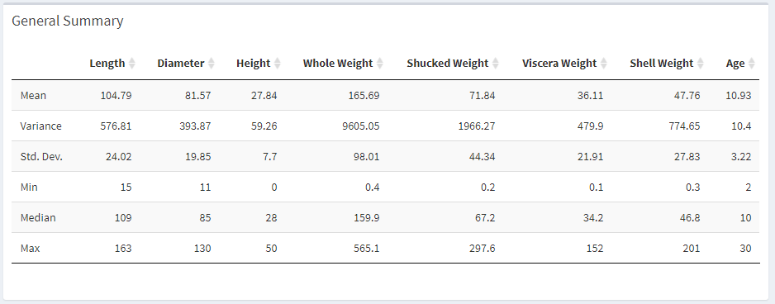
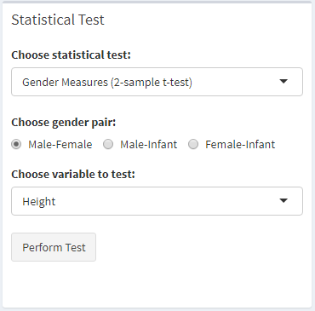
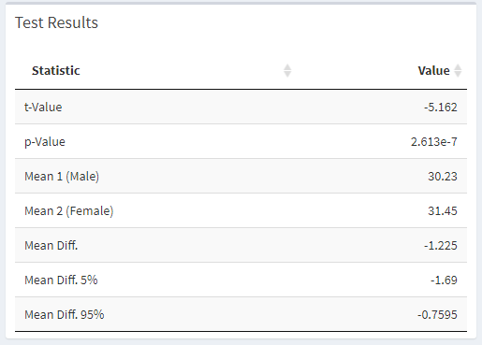
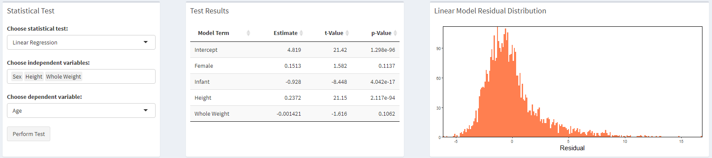
Data Statistics
Summary Statistics
2-Sample t-tests
Linear Regression (Linear Fit Test)
2-sample t-tests help to measure population differences between gender categories for numeric variables
Linear fit tests allow measurement of how good a linear fit is between any independent variables and any dependent variable
Linear fit includes a distribution of the residuals of the linear model
Helpful page for getting quick insights about the data and answering some questions about the data

Slide 5
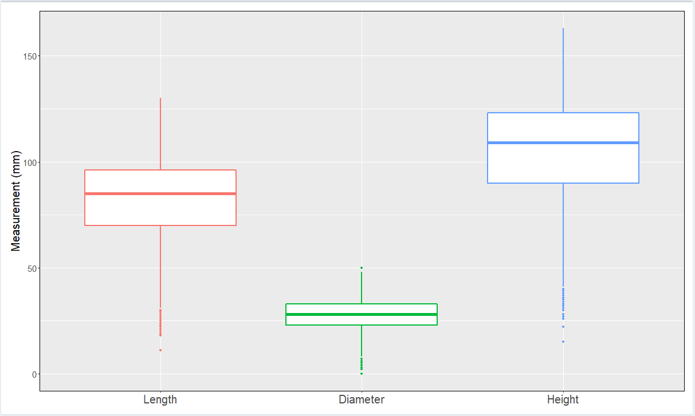
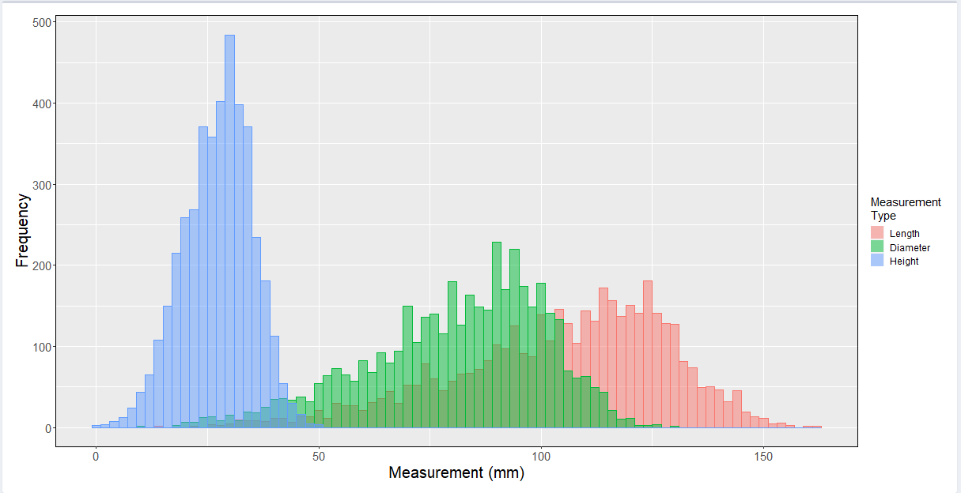
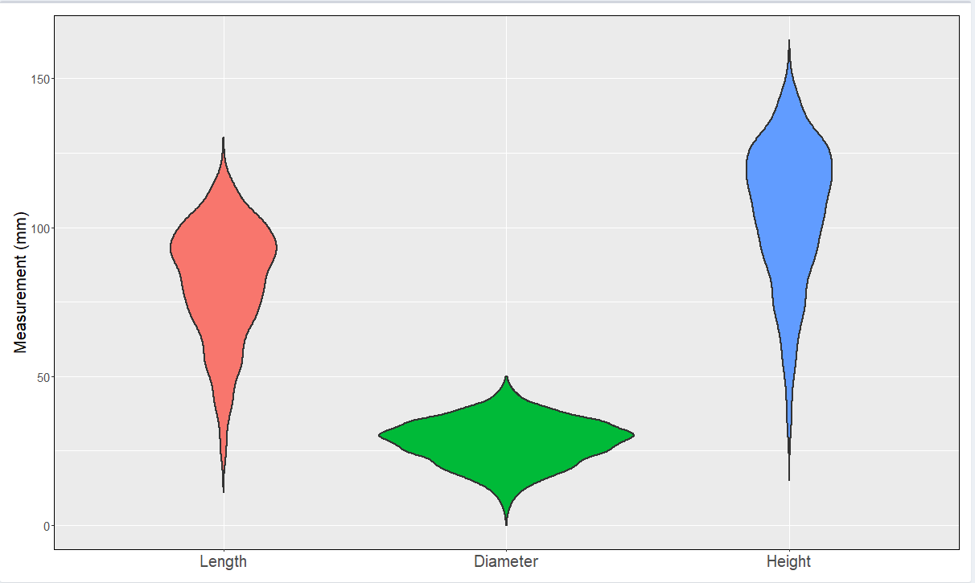
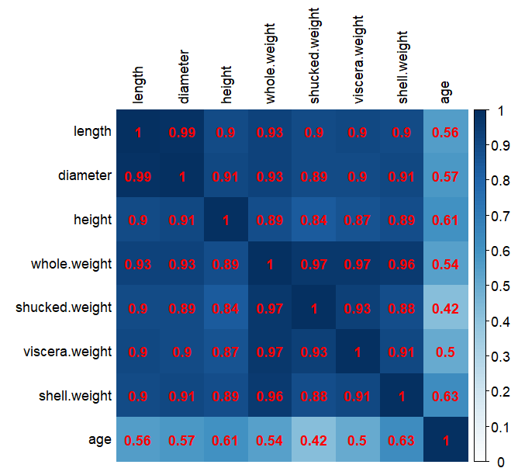
Data Exploration
Box Plots
Frequency Plots
Violin Plots
Correlation Plot
This page focuses on different visualizations of the data
Each plot has its own set of options
For box, frequency, and violin plots, you can look at plots for abalone dimension, weights, and age by gender
For the frequency plots, either a histogram or an area plot can be plotted
For the correlation plot, the user can specify which correlation method they want to use (Pearson, Spearman, Kendall)

Slide 6
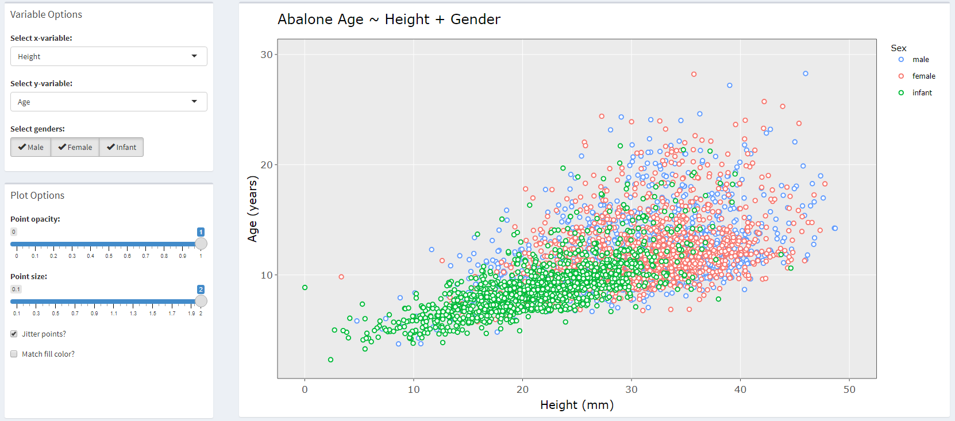
Interactive Visualization
Interactive Scatterplot with ggplot + plotly
This page offers an interactive scatterplot that can be used to look at how variables relate with each other
Any two non-categorical variables can be visualized
By default, the variable representing the sex of the abalone colors the points, but specific levels (male, female, infant) can be selected (or none which removes the coloring aesthetic)
Other customization options allow the user some flexibility in how they want to visualize the data
The plot is first made via ggplot and then rendered in plotly

Slide 7
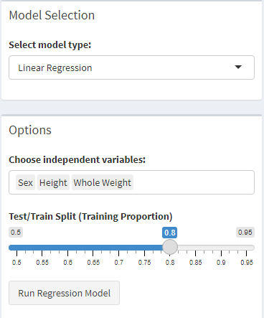
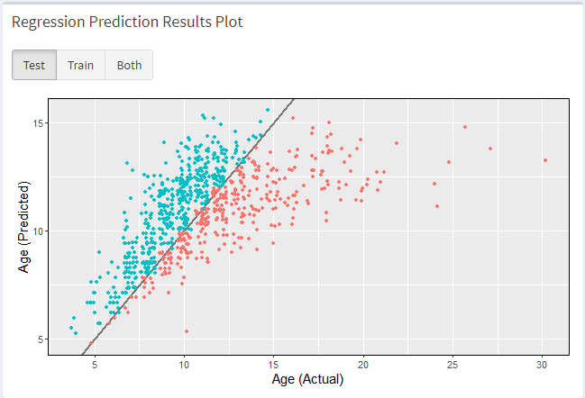
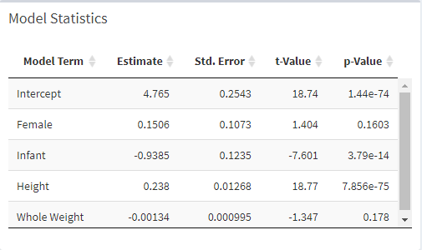
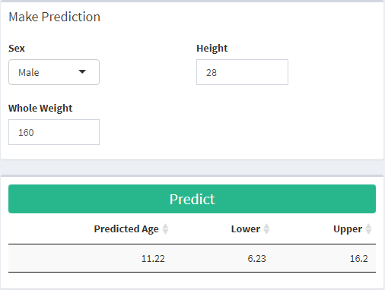
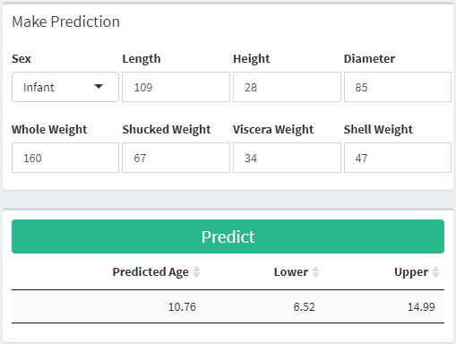
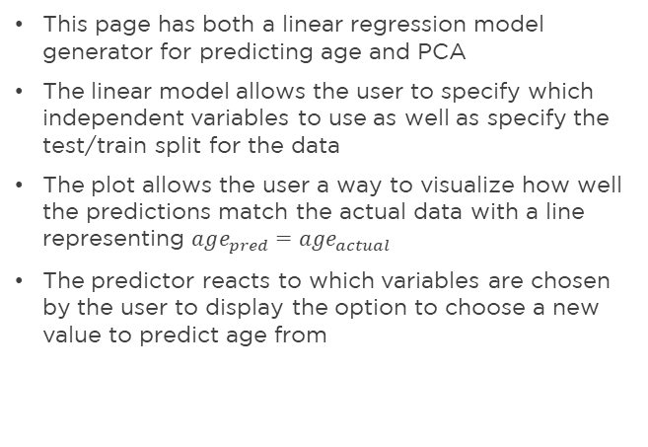
Models: Linear Regression
Options
Compare Actual vs. Predicted
Linear Regression Statistics
This page has both a linear regression model generator for predicting age and PCA
The linear model allows the user to specify which independent variables to use as well as specify the test/train split for the data
The plot allows the user a way to visualize how well the predictions match the actual data with a line representing $age_{pred}=age_{actual}$
The predictor reacts to which variables are chosen by the user to display the option to choose a new value to predict age from
Make predictions
Make predictions

Slide 8
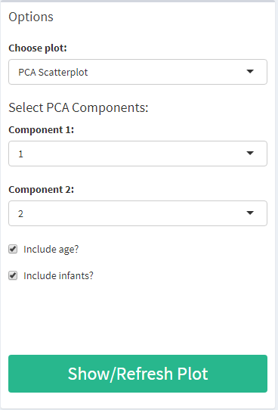
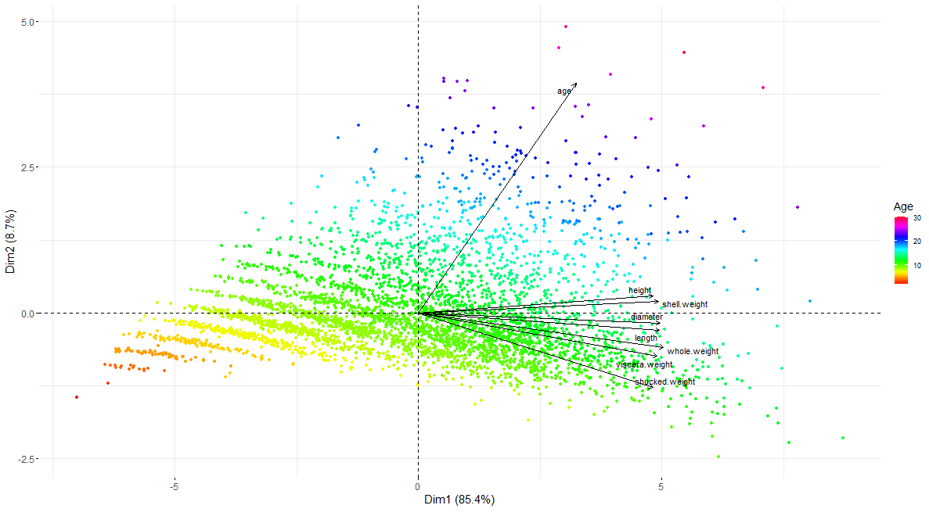
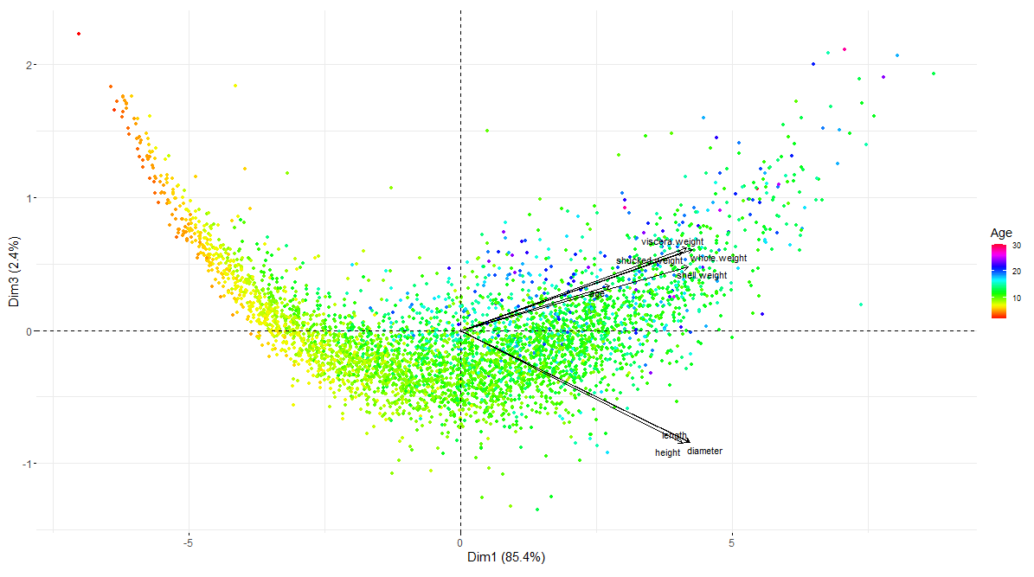
Models: PCA
Options
PCA Results Plot
The PCA selection on this page allows the user to perform PCA on the data with various options for visualization
The user can choose to exclude age or infants from the calculation
Any two of the PCA components can be plotted
PCA Results Plot

Slide 9
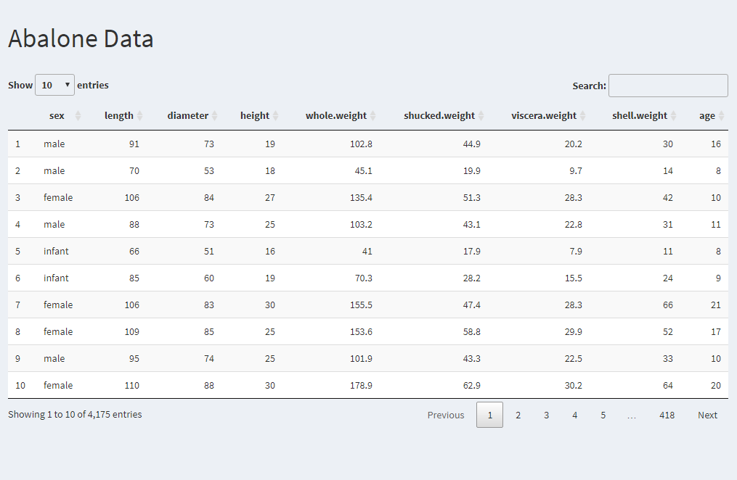
Data
Interactive Data Table
This page has an interactive table showing all of the data in the dataset

Slide 10
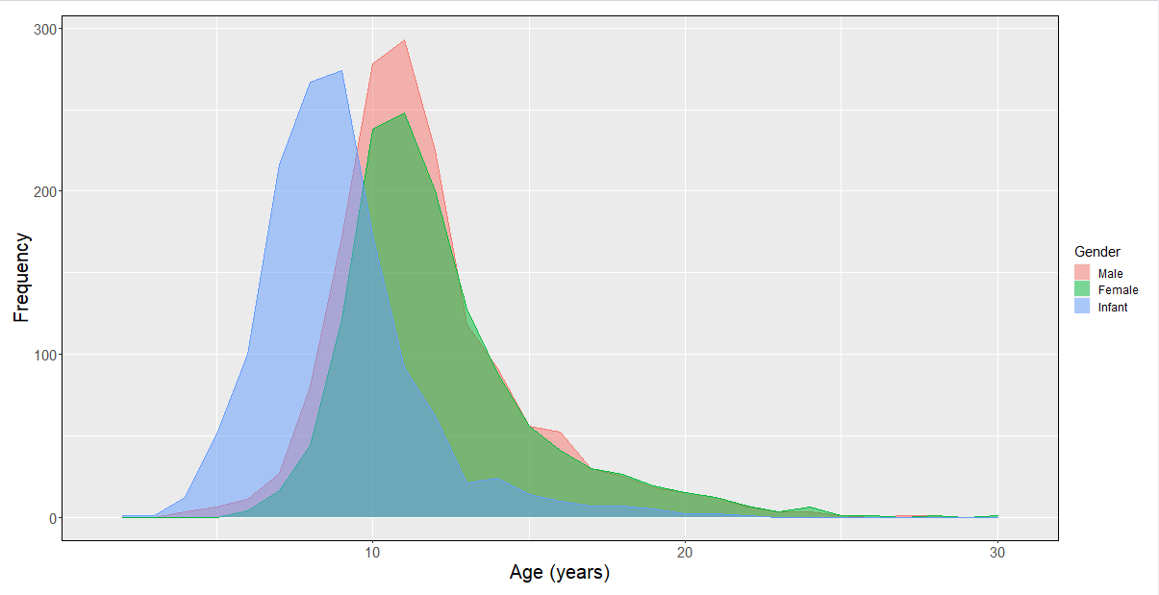
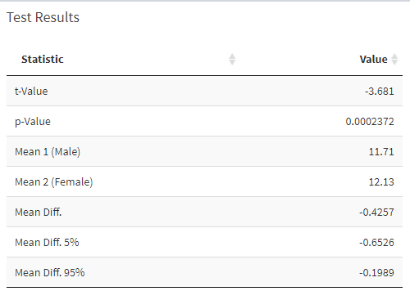
Insights
The distribution of ages between gender categories shows that (as expected) the infant category represents lower ages and male and female look to be distributed about the same
However, on the data statistics page, we can run a 2-sample t-test and we see that the p-value we get from this test is too low to conclude that these variables follow the same distribution

Slide 11
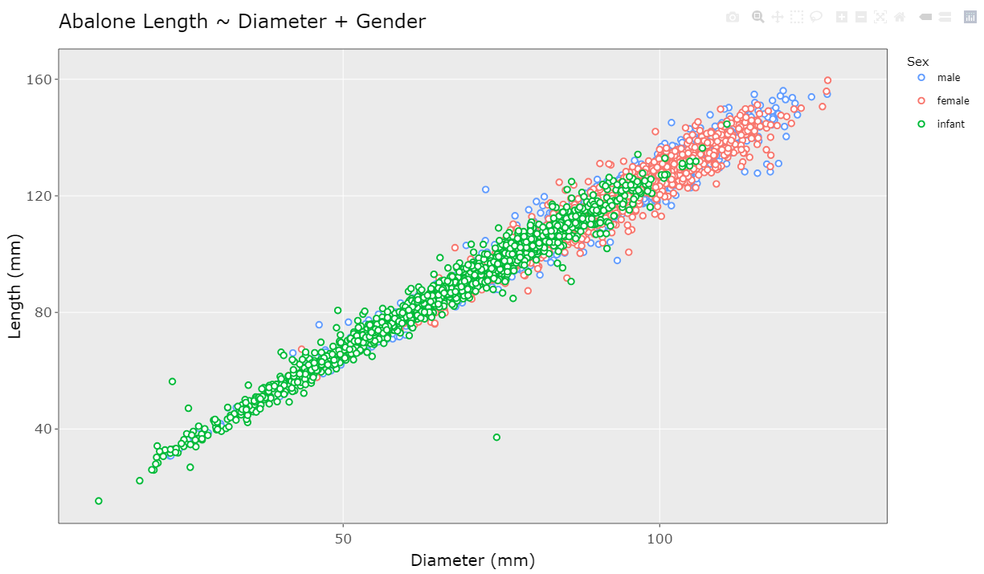
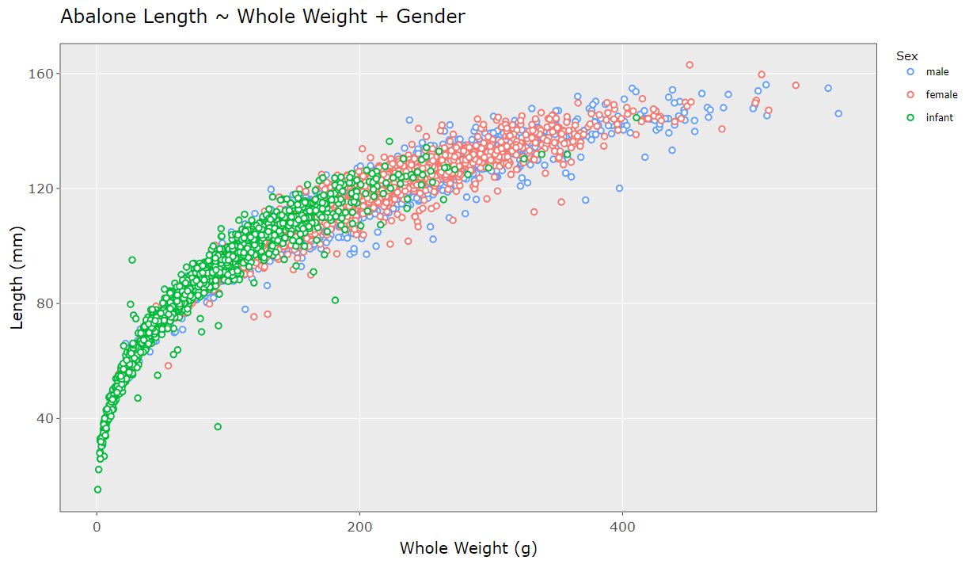
Insights (Cont.)
On the interactive visualization page, we can see that the length and diameter variables seem to be linearly related and thus in a prediction model using both may not be necessary
On the other hand, if we compare length and whole weight, we see a nonlinear relationship and thus using both of these variables in a prediction model would be useful

Slide 12
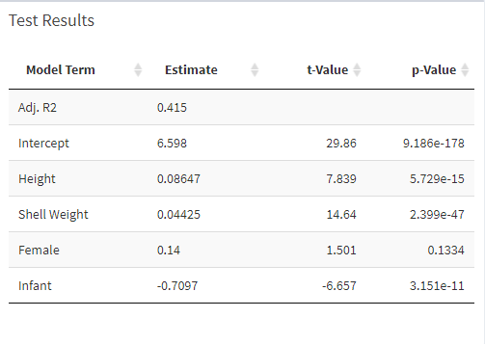
Insights (Cont.)
To help choose which variables we want to use in our prediction model, we can look at the correlation plot to see which variables correlate best with age
Choosing sex, height, and shell weight on the models page, we can look at how well these variables works for a linear regression on age
With an adjusted $r^{2}$ value of 0.415, we can see that this model accounts for about 42% of the variability in the data

Slide 13
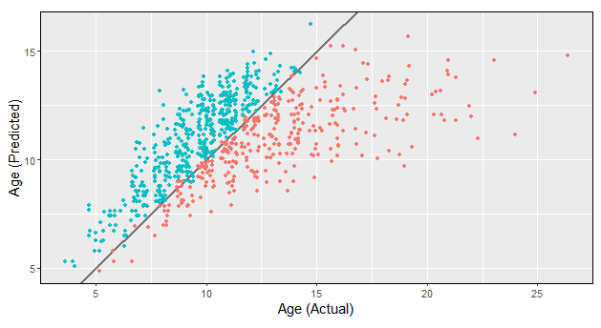
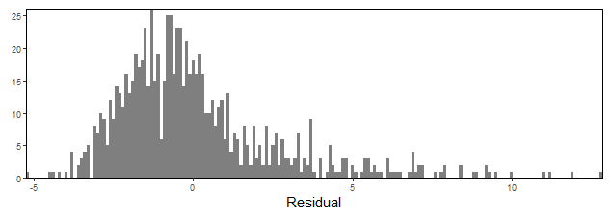
Insights (Cont.)
With a test/train split of (20/80), the predictions of this linear regression model on the test set can be visualized
We can see that the predictions seem to underestimate age more than overestimate, but are in the right neighborhood
This conclusion can also be seen by looking a the histogram of the residuals of prediction for the test set

Slide 14
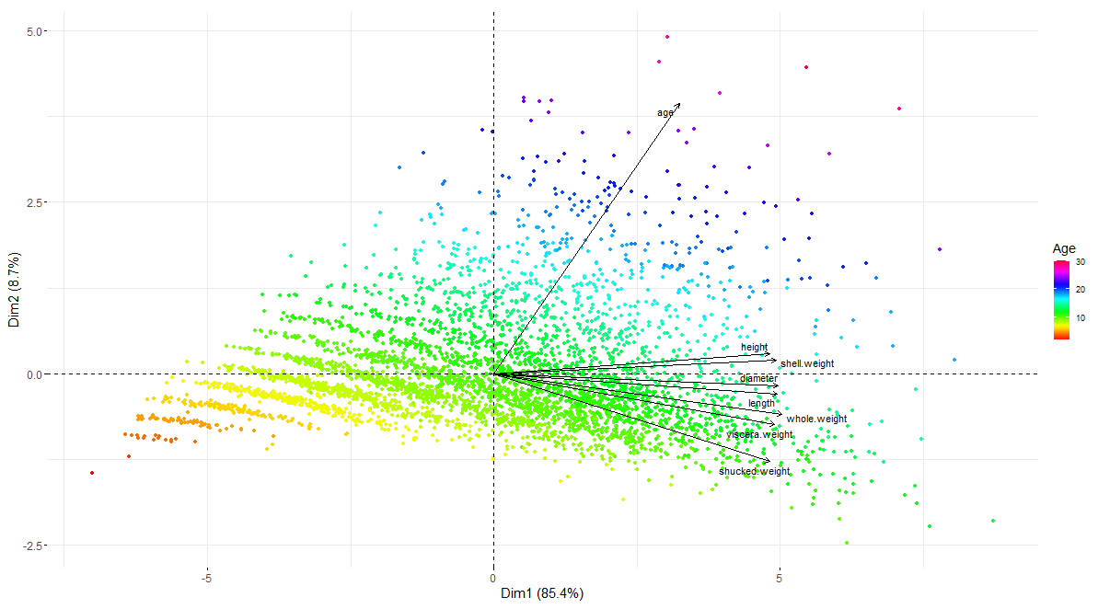
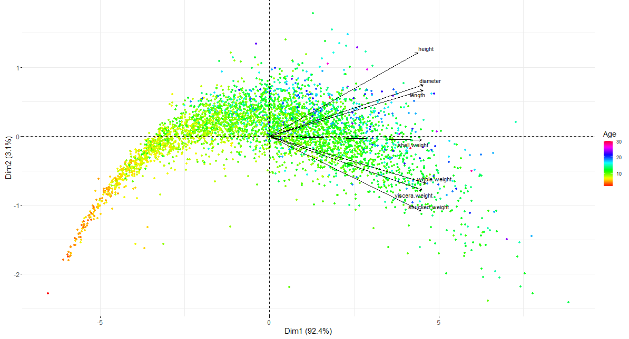
Insights (Cont.)
Looking at the PCA decomposition of the data, we can see that the bulk of the variance in the data is due to differences in physical measurements, while the rest mostly is due to differences in age
The first PCA mode primarily represents variations in physical measurement and the second mode represents variations in age
This result shows that using physical measurements to predict age will not be very useful as the physical measurements are too well correlated with each other and not well with age
Doing PCA without age can also help to inform which variables would be best to use in a prediction model

Slide 15
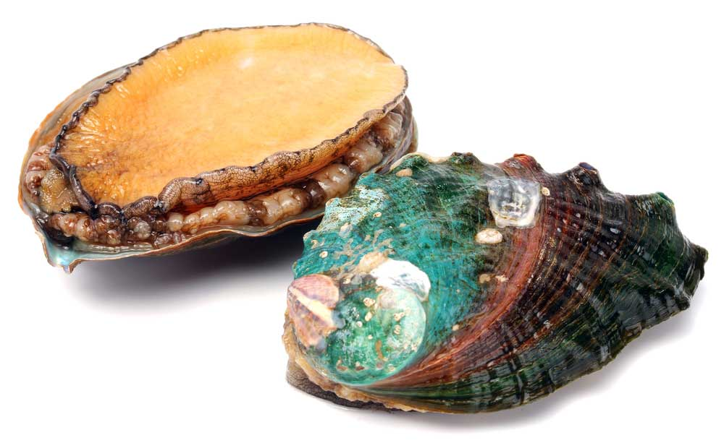
Conclusions
Shiny and shinydashboard are helpful in creating an easy way to visualize and explore complex data sets
The abalone dataset is a good dataset to test making predictions on data via other measurements and find which variables to use
The physical abalone measurements proved to not be particularly useful for making predictions about the age of the abalone
The reactive and dynamic structures that Shiny allows were very useful in trying out many combinations of variables and immediately getting results and visualizations

